Slide 1

Twitter streaming and analysis
ROBEL TEFERI

Slide 2
Outline
Introduction
Software's and Tools Utilized
Kafka Streaming Process
Storing Streaming data ( In Hive)
Spark SQL

Slide 3
introduction
Twitter is a communication medium where people of common interest could share information which is caped to not more than 140 characters. Twitter allows users to follow each other and approve or disapprove once idea.
The aim of this project is to analyse and store real time data that is consumed from twitter in real-time. A pipeline will be created which will contains a producer to publish the tweets into Kafka and a consumer will subscribe to Kafka to implement the analysis and store them in HDFS for further use.
The data consumed will also be used to create visualization using tools that enable to break it down to be easy enough to be understood by the business who have no technical knowledge of the tools or process.

Slide 4
Tools
Tools Utilized to create this project are :
Twitter API
Hive
Spark SQL
SPARK Streaming
KAFKA
Tableau

Slide 5
Prerequisite
Step 1
Twitter requires any user to open a developers account in order to utilize their APIs. They also require to have an account with them prior opening a developers account.
Step 2
Following step 1, to have an access to real-time data, it is required to open or create a twitter App. The procedure is self explanatory in the twitter and could be opened by following the step by step guide provided by Twitter.

Slide 6
Prerequisite
Step 1
Install Kafka into the VM
Step 2
Run zookeeper and kafka server
Create a topic –
Check list of topics created
bin/zookeeper-server-start.sh -daemon config/zookeeper.properties
bin/kafka-server-start.sh config/server.properties
./kafka-topics.sh --create --zookeeper localhost:2181 --replication-factor 1 --partitions 1 –topic RobelBDTProj
./kafka-topics.sh --list --zookeeper localhost:2181

Slide 7

KAFKA
Overview
Architecture
Kafka Connect
Kafka Stream

Slide 8

KAFKA
Kafka was designed to solve both problems
– Simplifying data pipelines
– Handling streaming data
Created by Linkedin in 2010
Apache open-source project since 2012

Slide 9
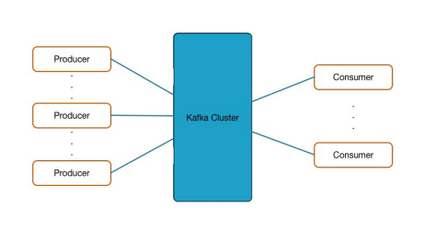
KAFKA -Overview
Kafka decouples data source and destination systems
– Publish/subscribe architecture
All data sources write their data to the Kafka cluster
All systems wishing to use the data read from Kafka

Slide 10
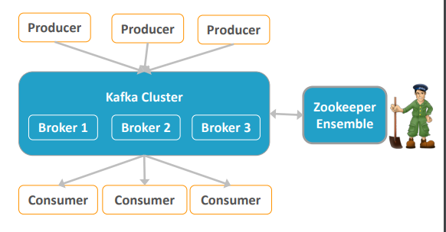
Architecture
Producer send data to the cluster
Consumers read data
Brokers are the main component for storage and messaging

Slide 11
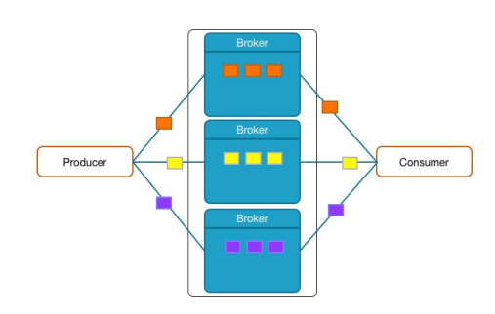
Architecture
Basic unit in Kafka is a message
Producers write messages to Brokers
Consumers read messages from Brokers
A message is a key-value pair

Slide 12
Architecture
Kafka maintains streams of messages in Topics
– Logical representation
– Categorize messages in groups
Developer decides which Topics exist
– Topic is auto created on first use
No limit in number of Topics
One or more Producer can write to the same Topic

Slide 13
Producers
Producers write data as messages to the Kafka cluster
Can be written in any language
A command line tool exists to send messages to the cluster
– For testing, debugging, et
Producers use a partitioning strategy to assign each message to a Partition
– Default is hash key of message key
Partitioning is used for
– Load balancing a share load across brokers
– semantic partioning a user-specified key allows locality-sensitive message processing
kafka-console-producer --broker-list localhost:9092 --topic test

Slide 14
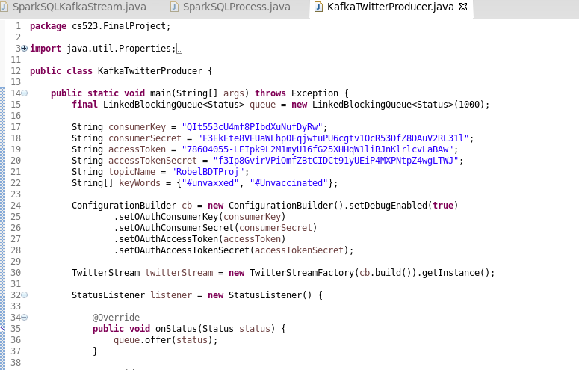
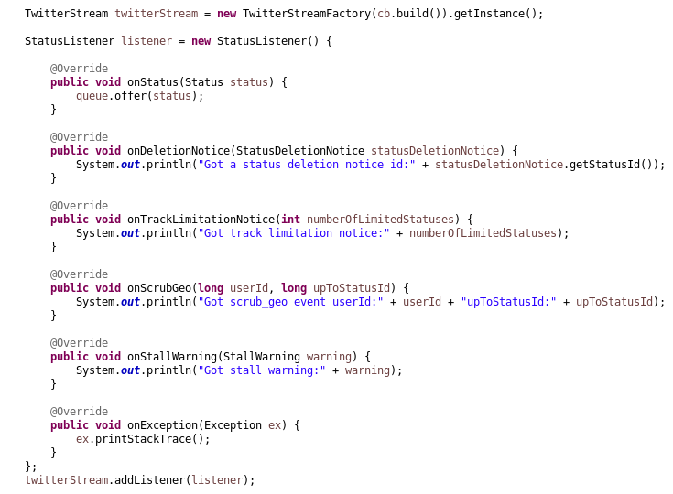
Producers

Slide 15
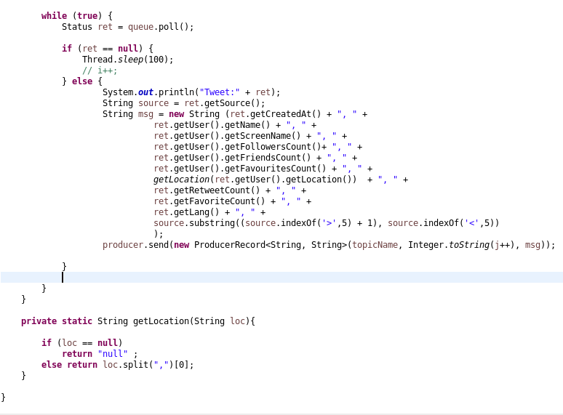
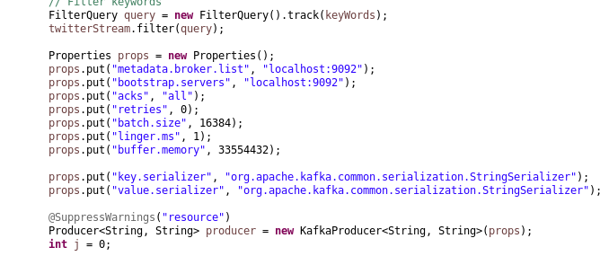
Producers

Slide 16
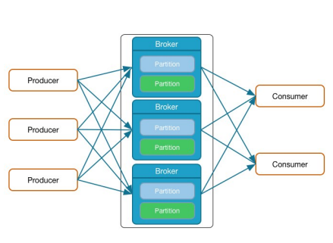
Brokers
Receive and store the messages send by Producers
A Kafka cluster has typically 3 or more brokers
Each can handle hundreds of thousands, or millions, of messages per second
Messages in a Topic are spread across Partitions in different Brokers
Each Partition is stored on the Broker’s disk as one or more log files
Do not get messed up with log4j logfiles
Each message in the log is identified by its offset number
Retention policy for messages to manage log file growth – Per Topic

Slide 17
- Consumer
Consumers pull messages from one or more Topics in the cluster
– Consumer will retrieve messages as they are written to the topic
The Consumer Offset keeps track of the latest message read
– Consumer Offset can be changed (if necessary) to reread messages
The Consumer Offset is stored in a special Kafka
Topic A command-line Consumer tool exists to read messages from the cluster
kafka-console-consumer --zookeeper localhost:2181 --topic test --from-beginning
kafka-console-consumer --bootstrap-server localhost:9092 --from-beginning --topic test

Slide 18
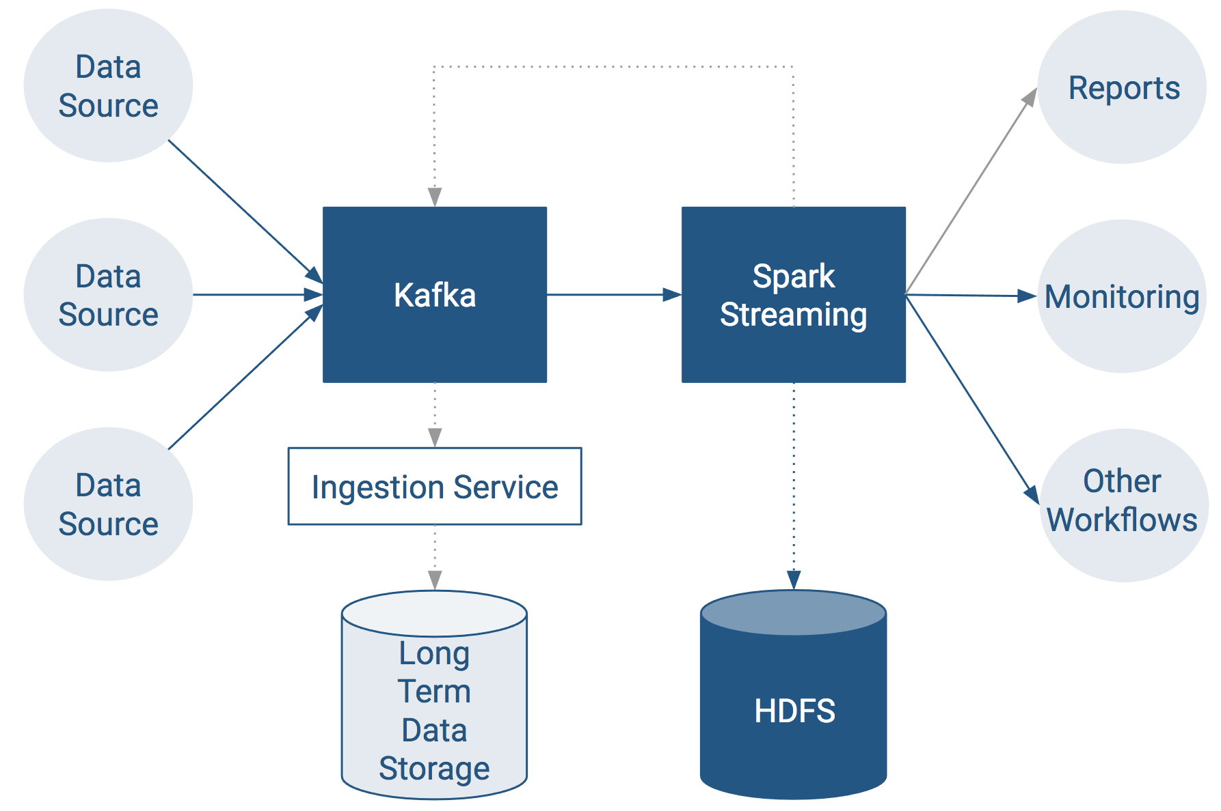
Kafka as stream-processing
End-to-End Data Streaming Pipeline

Slide 19
Spark SQL
It is Spark module for structured data processing
It provides programming abstraction called Data frames.
It integrates relational data processing with the functional programming API of Spark.
We can run queries either from terminal using spark-shell or from Eclipse or other IDEs.

Slide 20
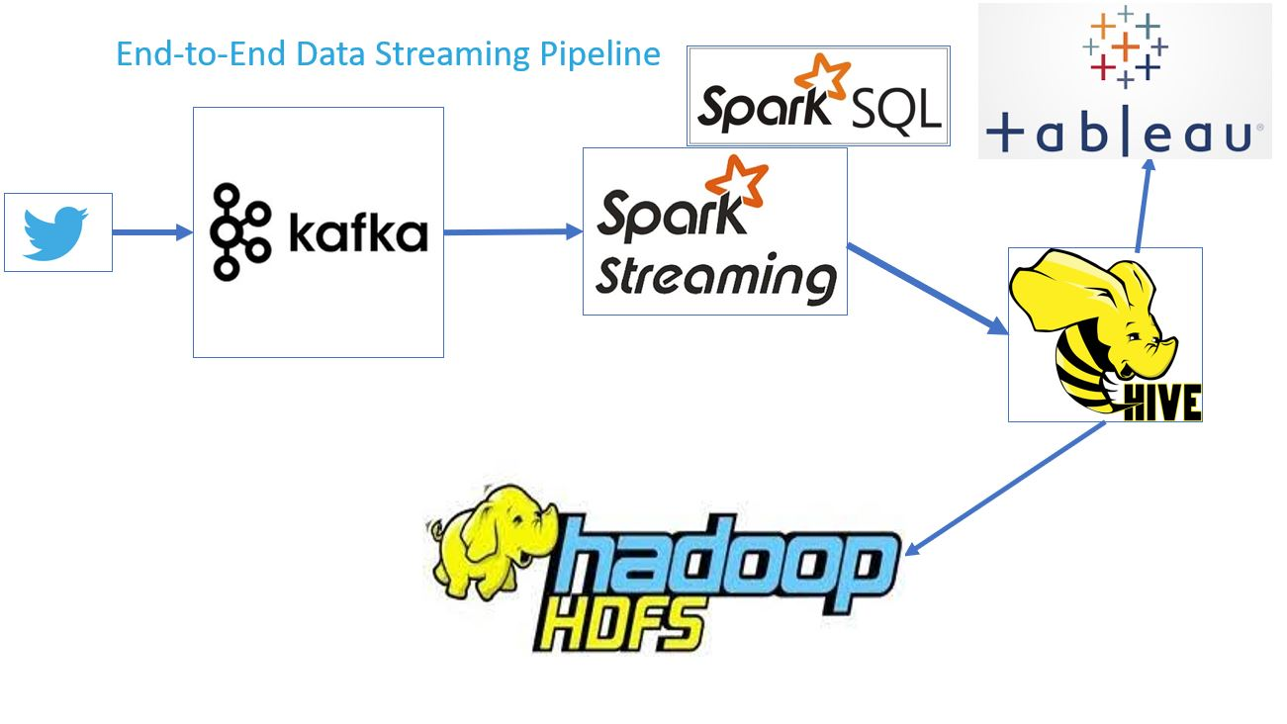
Process
The picture depicts the end to end data streaming pipeline what shows how data is consumed from twitter and processed, stored in HDFS cluster and further used to analyses and visualize the outputs in different formants.

Slide 21
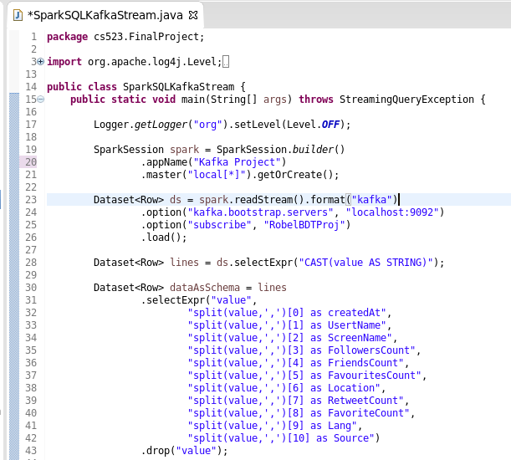
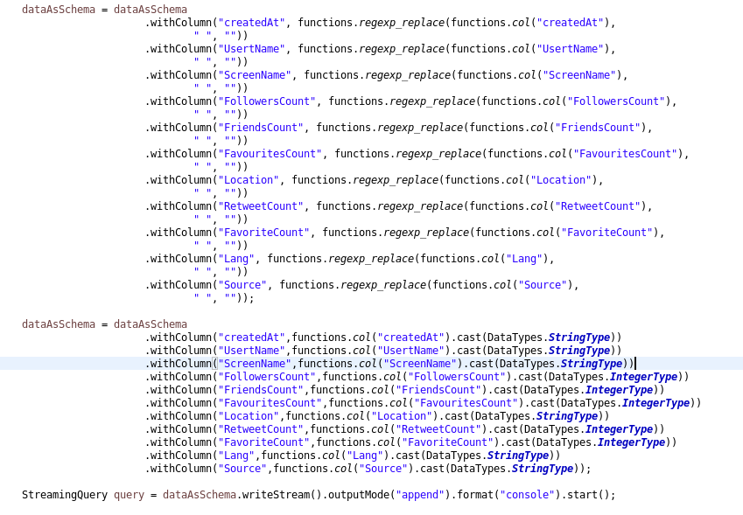
SPARK STREAMING

Slide 22
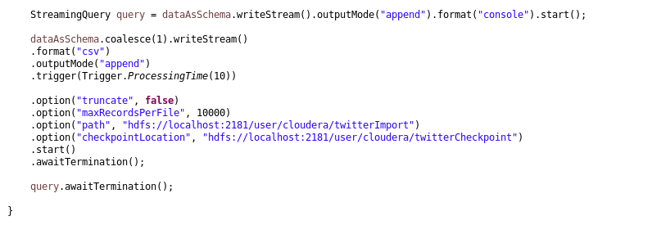
SPARK STREAMING

Slide 23
Data Visualization tableau

Slide 24
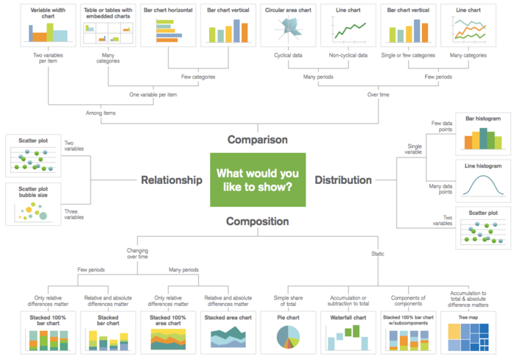

Slide 25
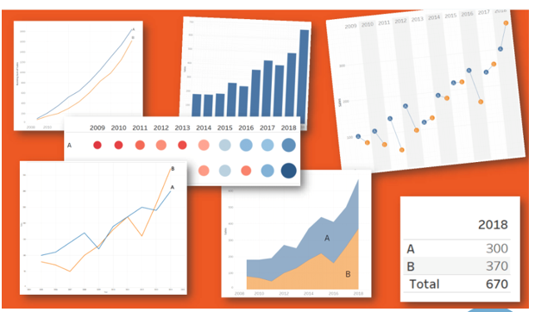
SPARK STREAMING

Slide 26
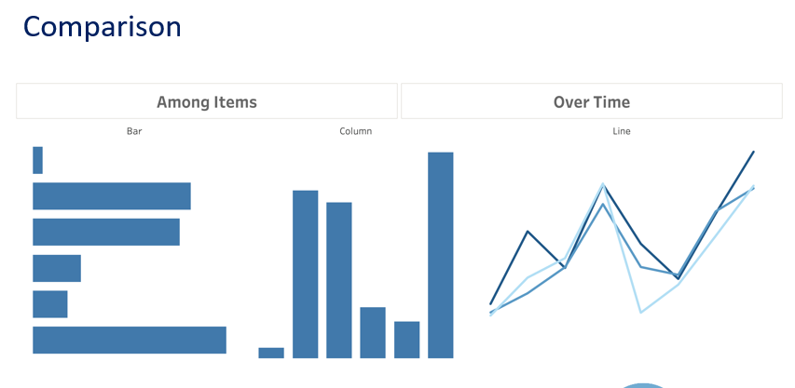

Slide 27
